Slide 1

Presentation On “Chest Cancer Classification System”
BY
Urmal Chide Arvind Dhage
Sushant Namurte Vaibhav Durge
B. Tech CSE SEM V
Guided by
Prof. Abhimanyu Dutonde
Department of Computer Science & Engineering
Tulsiramji Gaikwad Patil College of Engineering & Technology, Nagpur-441108
(An Autonomous Institute affiliated to RTMNU, Nagpur)
Session 2024-2025

Slide 2
Outline
Introduction
Literature Survey
Problem Statement
Project Objectives
Comparison Exiting and Proposed Architecture
Proposed Scheme
Modules
Flow of Implementation
Details of Implementation Work till date.
Conclusions
References

Slide 3
Introduction
The Chest Cancer Classification System is an AI-driven solution designed to accurately diagnose and classify chest cancers, such as lung and breast cancer, using medical imaging and clinical data. By leveraging machine learning algorithms, this system aims to enhance early detection, improve diagnostic accuracy, and provide personalized treatment recommendations. This innovative approach supports clinicians in making informed decisions, ultimately improving patient outcomes and optimizing healthcare resources.

Slide 4
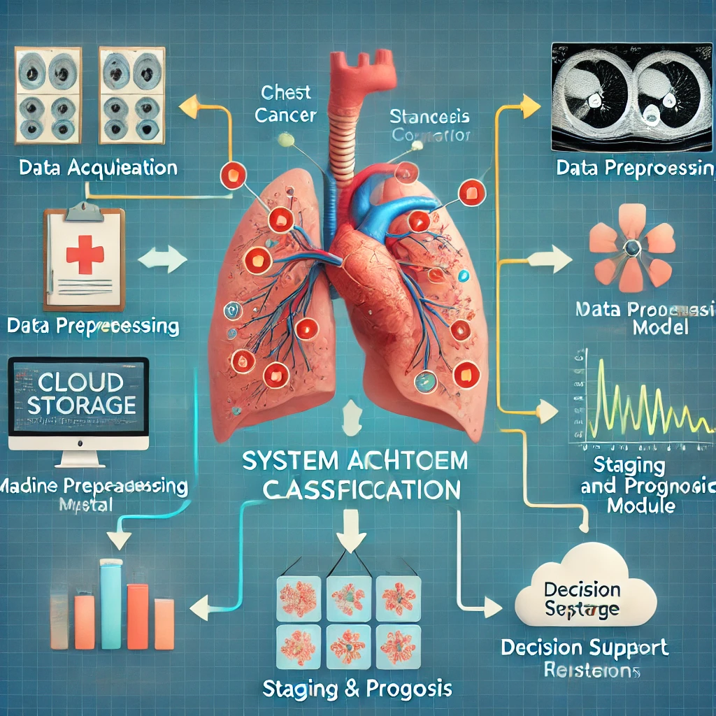
Architecture

Slide 5
Literature Survey
Current Trends in Chest Cancer Diagnosis
Recent studies highlight the increasing incidence of chest cancers, particularly lung cancer, emphasizing the need for effective diagnostic tools. Early detection is crucial for improving survival rates.
Role of Medical Imaging
Medical imaging techniques such as X-rays, CT scans, and MRIs are vital for identifying chest cancers. Innovations in imaging technology have enhanced resolution and diagnostic capabilities.
Machine Learning in Oncology
Machine learning models, especially Convolutional Neural Networks (CNNs), have shown promise in classifying medical images. Research demonstrates their effectiveness in distinguishing between malignant and benign tumors.
Data Integration Approaches
Combining imaging data with clinical and genomic information has been shown to improve classification accuracy. Multi-modal approaches facilitate personalized treatment plans.
Challenges and Opportunities
Despite advancements, challenges such as data variability, model interpretability, and regulatory compliance remain. Ongoing research aims to address these issues to enhance AI integration in clinical settings.
Impact of Decision Support Systems
Decision Support Systems (DSS) play a crucial role in guiding clinicians by providing treatment recommendations based on classification results, ultimately leading to better patient outcomes.
This literature survey emphasizes the evolving landscape of chest cancer classification, highlighting the integration of technology and data for improved diagnostic processes.

Slide 6
Problem Statement
Despite advancements in medical imaging and diagnostic techniques, chest cancer remains one of the leading causes of cancer-related mortality worldwide. Traditional diagnostic methods often rely on subjective interpretation, leading to delays in detection and misclassification. The increasing complexity of patient data, including imaging, clinical records, and genomic information, further complicates accurate diagnosis and personalized treatment planning. Therefore, there is a critical need for an automated Chest Cancer Classification System that leverages machine learning algorithms to enhance diagnostic accuracy, facilitate early detection, and support clinicians in making informed treatment decisions, ultimately improving patient outcomes.

Slide 7
Objectives
Develop an AI-based Classification System Create a robust system that accurately classifies different types of chest cancers using medical imaging and clinical data.
Enhance Diagnostic Accuracy Improve the precision of chest cancer diagnoses by utilizing advanced machine learning algorithms to reduce misclassification rates.
Facilitate Early Detection Enable early identification of chest cancers, leading to timely interventions and improved survival rates for patients.
Integrate Multi-modal Data Combine imaging data with clinical and genomic information to provide comprehensive insights for personalized treatment planning.
Support Clinician Decision-Making Develop a Decision Support System (DSS) that offers treatment recommendations based on classification results, aiding clinicians in making informed decisions.
Improve Patient Outcomes Ultimately enhance patient care by delivering more accurate diagnoses and tailored treatment strategies, contributing to better overall outcomes.

Slide 8
Existing System
Traditional Diagnostic Methods
Current approaches primarily rely on imaging techniques such as X-rays, CT scans, and MRIs, interpreted by radiologists.
Manual analysis can lead to variability in diagnosis and potential delays in treatment.
Histopathological Examination
Biopsy samples are often analyzed histologically to determine cancer type and stage.
This method is invasive and time-consuming, often resulting in delayed diagnosis.
Limited Use of AI
Some healthcare facilities have begun implementing basic AI tools, but their use is not widespread.
Existing AI models lack integration with clinical workflows and comprehensive data analysis capabilities.
Challenges in Data Integration
Current systems typically do not combine imaging data with electronic health records (EHRs) or genomic information, limiting the ability to provide personalized treatment plans.
Inconsistent Outcomes
The reliance on subjective interpretation in current systems can lead to inconsistent diagnostic outcomes and misclassification of cancer stages, affecting treatment effectiveness.

Slide 9
Proposed Scheme
AI-Driven Classification System
Develop a robust machine learning model, particularly utilizing Convolutional Neural Networks (CNNs), to classify chest cancers from medical imaging data with high accuracy.
Data Integration
Create a unified platform that combines medical imaging, clinical data, and genomic information to provide a comprehensive view of each patient's condition, enabling personalized treatment plans.
Enhanced Preprocessing Techniques
Implement advanced preprocessing methods, such as image normalization and data augmentation, to improve the quality and diversity of the dataset used for training the classification model.
Staging and Prognosis Module
Integrate a module that not only classifies cancer types but also determines the TNM staging and predicts patient prognosis, facilitating better treatment planning.
Decision Support System (DSS)
Design a user-friendly DSS that provides clinicians with actionable insights and treatment recommendations based on the classification results and staging information.
Continuous Learning and Improvement
Establish a feedback loop where the system continually learns from new data and user interactions, enhancing its predictive capabilities and accuracy over time

Slide 10
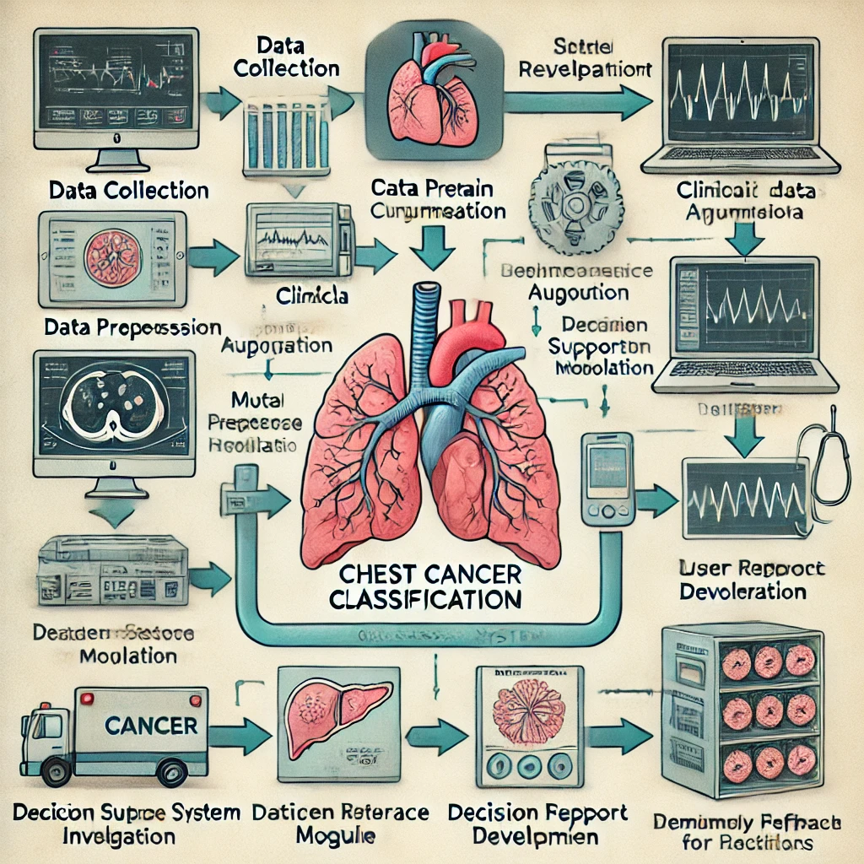
Flow of Implementation

Slide 11
SOFTWARE REQUIREMENT
Operating System
Windows 10/11 or Linux (Ubuntu): Compatible with the required software tools and libraries for machine learning development.
Programming Languages
Python: Primary language for implementing machine learning algorithms and data processing.
R: Optional for statistical analysis and data visualization.
Machine Learning Libraries
TensorFlow or PyTorch: Frameworks for building and training deep learning models, especially Convolutional Neural Networks (CNNs).
Scikit-learn: For traditional machine learning algorithms and model evaluation.
Data Processing Tools
OpenCV: For image preprocessing and manipulation.
Pandas: For data handling and manipulation.
NumPy: For numerical computations and array operations.
Visualization Tools
Matplotlib and Seaborn: For plotting and visualizing data insights and model performance.
Tableau: Optional for advanced data visualization and dashboard creation.
Database Management
SQL or MongoDB: For managing and querying clinical and imaging data efficiently.
Integrated Development Environment (IDE)
Jupyter Notebook: For interactive coding and data exploration.
PyCharm or VS Code: For software development and debugging.
Cloud Services (if applicable)
AWS, Google Cloud, or Microsoft Azure: For scalable storage and computation resources.
Summary

Slide 12
Details of Implementation Work
Data Collection
Gather a diverse dataset of chest images (X-rays, CT scans) and associated clinical data from hospitals and publicly available databases to ensure comprehensive representation.
Data Preprocessing
Image Processing: Apply normalization, resizing, and augmentation techniques to improve image quality and enhance model training.
Data Cleaning: Remove any duplicates or irrelevant data points from clinical records to ensure data integrity.
Model Development
Architecture Selection: Choose appropriate machine learning models (e.g., CNN) based on the specific requirements for image classification.
Training: Utilize the processed dataset to train the model, adjusting hyperparameters to optimize performance.
Model Evaluation
Assess model accuracy using metrics such as precision, recall, F1-score, and ROC-AUC on a separate validation dataset.
Perform cross-validation to ensure the model's robustness and reliability.
Integration of Staging and Prognosis Module
Develop algorithms to assess the stage of cancer based on classification results, incorporating clinical guidelines for staging.
Decision Support System (DSS) Development
Create a user-friendly interface that provides clinicians with diagnostic results, staging information, and treatment recommendations based on model outputs.
User Interface Design
Design an intuitive dashboard for clinicians to easily access patient data, view classification results, and make informed decisions.
Deployment
Implement the system within hospital infrastructure, ensuring seamless integration with existing clinical workflows and data management systems.
Monitoring and Feedback
Establish a framework for continuous monitoring of system performance and gathering user feedback to identify areas for improvement and updates.

Slide 13
Conclusion
The Chest Cancer Classification System represents a significant advancement in the early detection and diagnosis of chest cancers. By leveraging machine learning and advanced imaging techniques, this system enhances diagnostic accuracy and supports personalized treatment plans, ultimately improving patient outcomes.
The integration of diverse data sources and real-time decision support tools empowers clinicians to make informed decisions, ensuring timely interventions. Despite challenges in implementation, continuous monitoring and feedback mechanisms will facilitate ongoing improvements to the system. As healthcare technology evolves, the Chest Cancer Classification System holds great promise for transforming cancer care and enhancing survival rates for patients worldwide.

Slide 14
References
Siegel, R. L., Miller, K. D., & Jemal, A. (2023). Cancer Statistics, 2023. CA: A Cancer Journal for Clinicians, 73(1), 17-48.
Provides insights into cancer prevalence and survival rates.
Sandler, J. E., et al. (2021). Convolutional Neural Networks for Radiologic Image Classification in Chest Cancer: A Systematic Review. Radiology, 299(3), 672-682.
Reviews the application of CNNs in medical imaging for cancer diagnosis.
Bendtsen, M., & Rosell, R. (2020). AI in Thoracic Oncology: Early Diagnosis and Personalized Treatment. The Lancet Oncology, 21(9), e457-e465.
Discusses the impact of AI on early cancer detection and treatment personalization.
He, K., Zhang, X., Ren, S., & Sun, J. (2016). Deep Residual Learning for Image Recognition. Proceedings of the IEEE Conference on Computer Vision and Pattern Recognition, 770-778.
Introduces ResNet architecture, significant for deep learning in medical imaging.
Tan, M., & Le, Q. V. (2019). EfficientNet: Rethinking Model Scaling for Convolutional Neural Networks. Proceedings of the 36th International Conference on Machine Learning, 6105-6114.
Details a scalable model architecture applicable in medical image classification.
Pérez-García, F., Sparks, R., & Ourselin, S. (2021). TorchIO: A Python Library for Efficient Loading, Preprocessing, Augmentation, and Sampling of 3D Medical Images in Deep Learning. Journal of Open Source Software, 6(66), 2825.
Describes tools for preprocessing medical images, essential for accurate classification.
National Comprehensive Cancer Network (NCCN) (2024). NCCN Guidelines for Non-Small Cell Lung Cancer.
Offers clinical guidelines for lung cancer diagnosis and treatment.
World Health Organization (WHO) (2022). Global Cancer Statistics.
Provides global statistics and data on cancer incidence and mortality.

Slide 15
Thank You

